Slide 1
Pagination Made Easy
Aaron Felton & Rae Ellingham

Slide 2

Introduction
Who are we?
What are we talking about?
Notes:
Hi my name is Aaron, this is my co-pilot Rae.
We’re from Red Olive. “A data services consultancy that is focused on being able extract and maximise the benefit of the most valuable asset any business owns – their data.“
In this introductory session I hope to demystify some of the overlap between Power BI and Report Builder, and to help you know when one should be used over the other.
We’ll look at what pagination is, how we can leverage it to do some interesting things, and we’ll have a short demonstration on how to paginate.

Slide 3



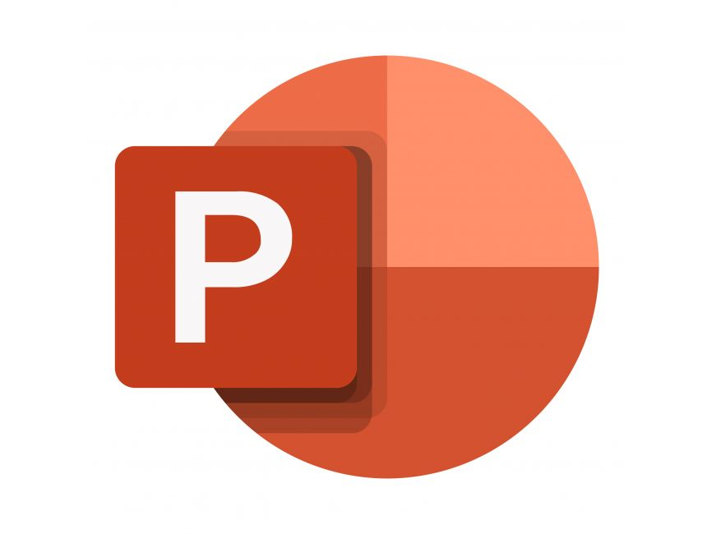
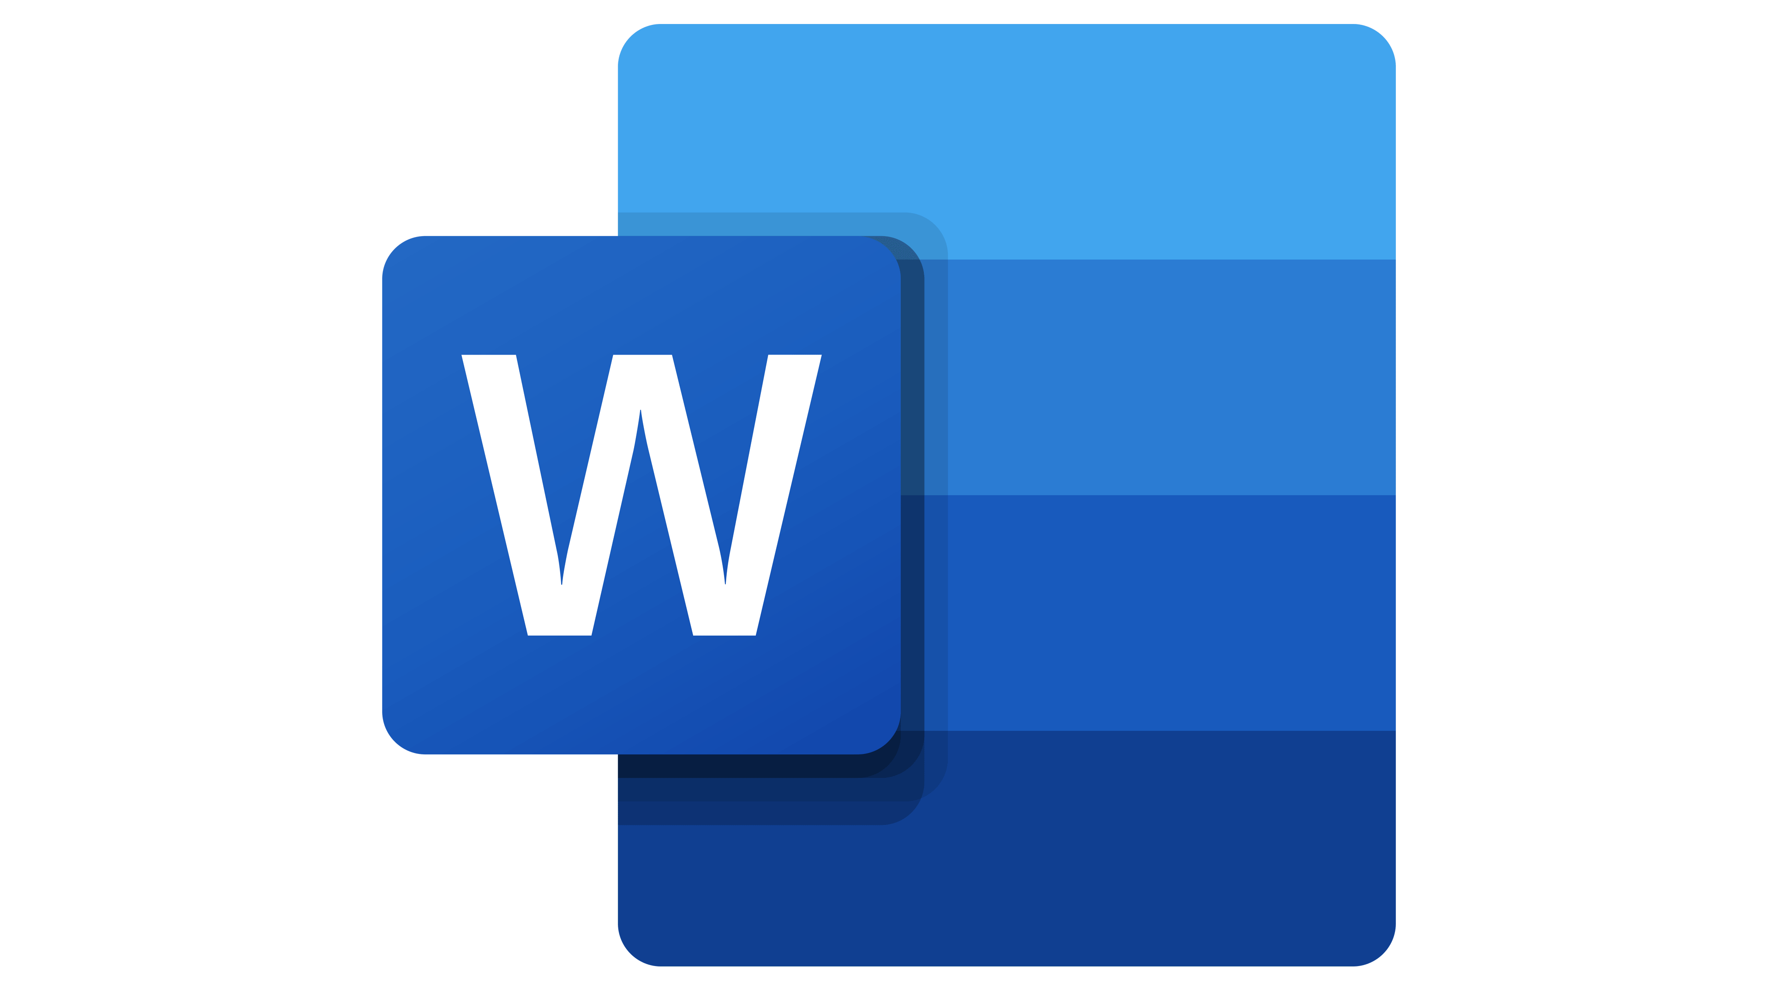


Automated alerts
Bespoke Presentations
Schematics
Dashboards / Wallboards
Data driven email bombs
Notes:
Report builder is a tool.
And like the other tools in our lives, we decide when it’s appropriate to use them.
For me, I’ve had to continually reassess the tool and how it fits in with everything else I used. However I wont lie.. I loved using the early versions Report Builder.. for everything 😐
- I was using it create automated alerts through data-driven subscriptions. I was using it to create wallboards with scrolling informative tikker tapes, I even created building schematics - overlayed heating system outputs…
Hindsight is a wonderful thing!

Slide 4
Why should you use Report Builder?
It lacks interactive features….
It lacks the range of visuals available….
It just isn’t as intuitive… (subjective)
So why are we using it? XD
Notes:
Such as cross highlighting and cross filtering, expanding and pinning visuals…
It has a few good options for visualization, but not the range of options that Power BI offer.
It just isn’t as intuitive for a beginner… but there is less to learn so it’s probably easier to master.
So, why? Remember.. it’s always been optimized for printing and generation of PDFs

Slide 5
Why should you use Report Builder?
 | Report Builder | Power BI
Purpose | Creates paginated reports optimized for printing or generating PDFs. | Provides more advanced reporting capabilities for creating interactive reports and dashboards.
Visual and interactivity | Basic visuals like tables, matrices and charts. Lacks advanced visualisations and interactive features. | Vast library of visuals and advanced interactivity (droll-down, cross-filtering/highlighting).
Formatting | Highly customisable pixel-perfect page and visual formatting. Optimised for printing and pagination. | A variety of theme-based formatting options for pages and visuals. Various customisations, but can be less flexible.
Ease of use | Less intuitive, can be confusing at first. | Easy to learn but difficult to master
Notes:
it comes with a high degree of control over page layout and formatting.
- You can dynamically control almost everything, borders, colors, text sizes, fonts. Everything can be visibly turned on or off... Dynamic column widths, table layouts and so much more
And.. it’s able to export more data, and gives you more control over what is exported. Power BI has some limitations and can be somewhat inflexible.
Most importantly, it’s ability to do all of this and ‘Paginate’ our data, is what sets it apart from Power BI.

Slide 6
What is Pagination?
Bill Date | Bill Amount | Bill Id | Customer Id
01/12/24 | 86.65 | 1 | 1
01/01/24 | 98.78 | 2 | 1
01/12/24 | 14.36 | 3 | 2
01/01/24 | 19.58 | 4 | 2
01/12/24 | 37.45 | 5 | 3
01/01/24 | 32.12 | 6 | 3
Greetings Customer 1
Here are your Bills
01/12/2024 | 86.68
01/01/2024 | 98.78
Notes:
Conceptionally, it’s very simple.
Pagination is where we take a table of data and identify a row group, then iteratively convert all the rows within that group into pages.
The rows within the grouped data, can then be layed out on a page as suits our needs.
Report builder can use this feature to visualise data in a variety of different ways.
- For example

Slide 7
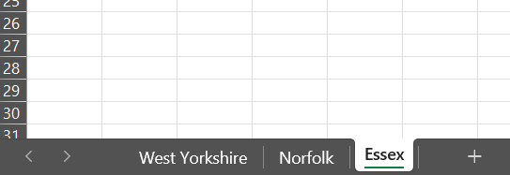
What is Pagination?
Bill Date | Bill Amount | Bill Id | Customer Id | County
01/12/24 | 86.65 | 1 | 1 | West Yorkshire
01/01/24 | 98.78 | 2 | 1 | West Yorkshire
01/12/24 | 14.36 | 3 | 2 | Norfolk
01/01/24 | 19.58 | 4 | 2 | Norfolk
01/12/24 | 37.45 | 5 | 3 | Essex
01/01/24 | 32.12 | 6 | 3 | Essex
01/12/24 | 24.18 | 7 | 4 | Essex
01/01/24 | 22.99 | 8 | 4 | Essex
Notes:
It can be used to dynamically create and name tabs in Excel, and all of the rows within that group can be templated into a worksheet.

Slide 8
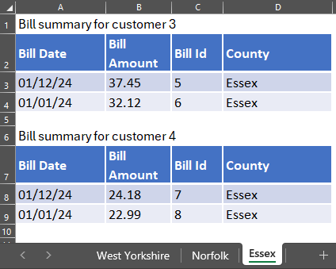
What is Pagination?
Bill Date | Bill Amount | Bill Id | Customer Id | County
01/12/24 | 86.65 | 1 | 1 | West Yorkshire
01/01/24 | 98.78 | 2 | 1 | West Yorkshire
01/12/24 | 14.36 | 3 | 2 | Norfolk
01/01/24 | 19.58 | 4 | 2 | Norfolk
01/12/24 | 37.45 | 5 | 3 | Essex
01/01/24 | 32.12 | 6 | 3 | Essex
01/12/24 | 24.18 | 7 | 4 | Essex
01/01/24 | 22.99 | 8 | 4 | Essex
Notes:
You can even take a sub-group from our data, and generate multiple tables on a page, one for each iteration.
Sort of like… pagination within pagination.

Slide 9
What use cases does Pagination address?
Formatting around strict business requirements
Overflow handling
Templated production of PDF documents
Examples
Financial statements
Customer invoices or account summaries
Work orders and shipping labels
Legal documentation
Transcripts & Certificates
Notes:
- 1
It’s critical, that we understand our consumer and our requirements before choosing a tool like Report Builder.
- Be careful that you understand that you’re trade those interactive features of Power BI that enhance our users analytical experience, for a strict, conformed data output that may not always allow for exploration to gain new insights..
- 2
Data grid layouts in Report Builder can expand and overflow across multiple pages in a controlled manner. Unlike Power BI reports, which provide scroll bars for out-of-view data, pagination ensures that all content is visible when exported.
- This can even extend to automatically overflowing sets of records within a table, to a new page or tab.
- 3
While you can technically use these features to produce highly formatted Excel reports, it’s typically used to produce PDFs such as

Slide 10

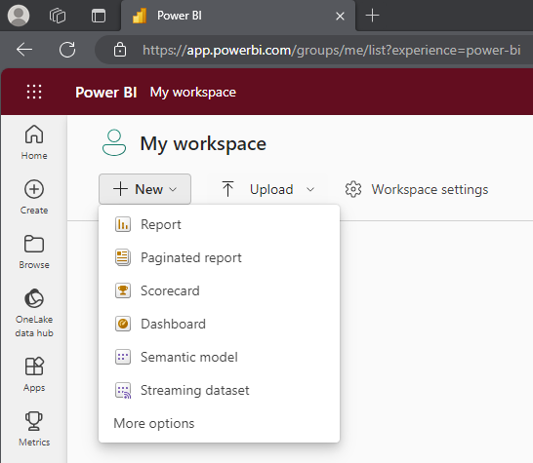
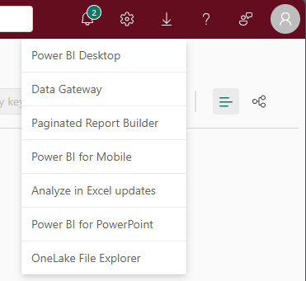
Demo
In this demo I will show you how to:
- Extract some DAX from Power BI
- Create a dataset in Report Builder
- Use row-groups to paginate

Slide 11
Any questions?

